Slide 1
Background: Qualitative and Document Analysis
    Research question: How do individual Soldier characteristics contribute to Soldier and unit performance?
    Goals:
      Identify qualities or characteristics that the Army considers important for successful Soldier and unit performance (i.,e., potential predictors, moderators, mediators)
      Provide important context to inform ongoing construction and interpretation of statistical models of Soldier performance (e.g., identify major shifts in training or doctrine, enhance timeline of major Army events)
        Refine and adjust models according to themes
        Depends on data availability
      Extend work to unit performance without requiring unit-level measurement

Slide 2
Background: Corpus
    Army administrative documents
      Officer Professional Development and Career Management (PAM 600-3) from 1998-2019
        Oct. 1998, Oct. 2005, Dec. 2005, Nov. 2007, Dec. 2007, Feb. 2010, Dec. 2014, June 2017, Apr. 2019
        ~ 500 pages each
      Army Leadership and the Profession (ADP 6-22)
      Evaluation Reporting System (PAM 623-3)
      Performance Evaluation Guide - Leadership Requirements Model and Example Behavioral Indicators (AR-623-23)
      Building Cohesive Teams Handbook
      Leader Development (FM 6-22)
      Leaders Guide to Team Building Handbooks
      Soldier’s Guide (TC 7-21.13)
    Team science literature
      Svyantek, D. J., Goodman, S. A., Benz, L. L., & Gard, J. A. (1999). The relationship between organizational characteristics and team building success. Journal of Business and Psychology, 14(2), 265-283.
      Cohen, S. G., & Bailey, D. E. (1997). What makes teams work: Group effectiveness research from the shop floor to the executive suite. Journal of management, 23(3), 239-290.
Notes:
Describe corpus: Include full names and years for all documents
Information from https://uva-bi-sdad.github.io/dspg22ari2/data.html
Plus green documents, international comparison, 10 pams
Put whole title of 600-3

Slide 3
Background: Methods
    Manual Qualitative Coding
      Time consuming for researchers
      Unable to achieve a level of good agreement
    Topic Modeling
      Without qualitative coding results are difficult to interpret
      Terms like “team” and “Army” appear in several topics making differentiation between topics difficult
    Term Frequency Inverse Document Frequency (TF-IDF)
      Acronyms and abbreviations rose to the top
        E.g. JIIM (Joint, Interagency, Intergovt, Multinational), CERS (Consolidated Emergency Response System)
        What’s the contextual difference?

Slide 4
New Corpus
    45 Army Administrative documents from 1946-2021, including
      8 FM 7-15s (Field Manual on the Army Universal Task List)
      10 FM 22-10s (Field Manual on Military Leadership)
      5 FM 7-0s (Field Manual on Training)
    Items from the Global Assessment Tool (GAT) assessing social characteristics of Soldiers, e.g.
      Spiritual fitness – “It is very much like me that my life has lasting meaning.”
      Friendship – “I do have someone to talk to when I feel down.”
    Constructs from Tailored Adaptive Personality Assessment System (TAPAS) assessing social characteristics of Soldiers (will do)
    Bonus: Center for Army Profession and Leadership (CAPL) document on the thematic changes in most of our corpus

Slide 5
Methods
    Research questions:
    How have descriptions of performance in the Army changed over time? What descriptive and prescriptive behaviors are associated with being "good" Soldiers?
    How well do items assessing Soldier social characteristics align with the Army’s idea of performance?
    Bidirectional Encoding using Transformers (BERT)
      Output is a numerical representation of documents
      Captures the contextual relationships between words in a sentence and across documents
      Used to identify emergent and unobservable constructs
      We compare documents using a distance measure (cosine similarity)

Slide 6
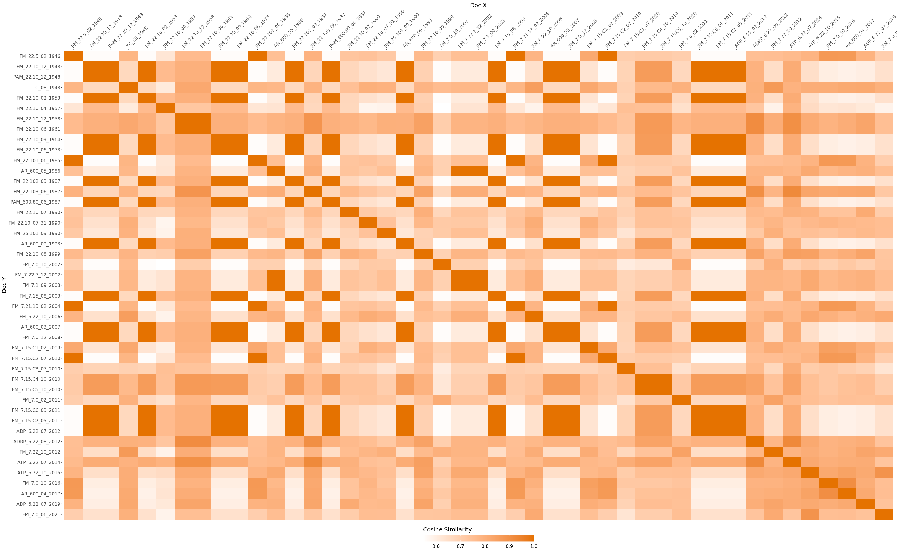
Example results: Cosine similarity between all documents
Most dissimilar documents (mean cosine similarity < .6)
Since 2012, there seems to be relatively more cohesion between all documents

Slide 7
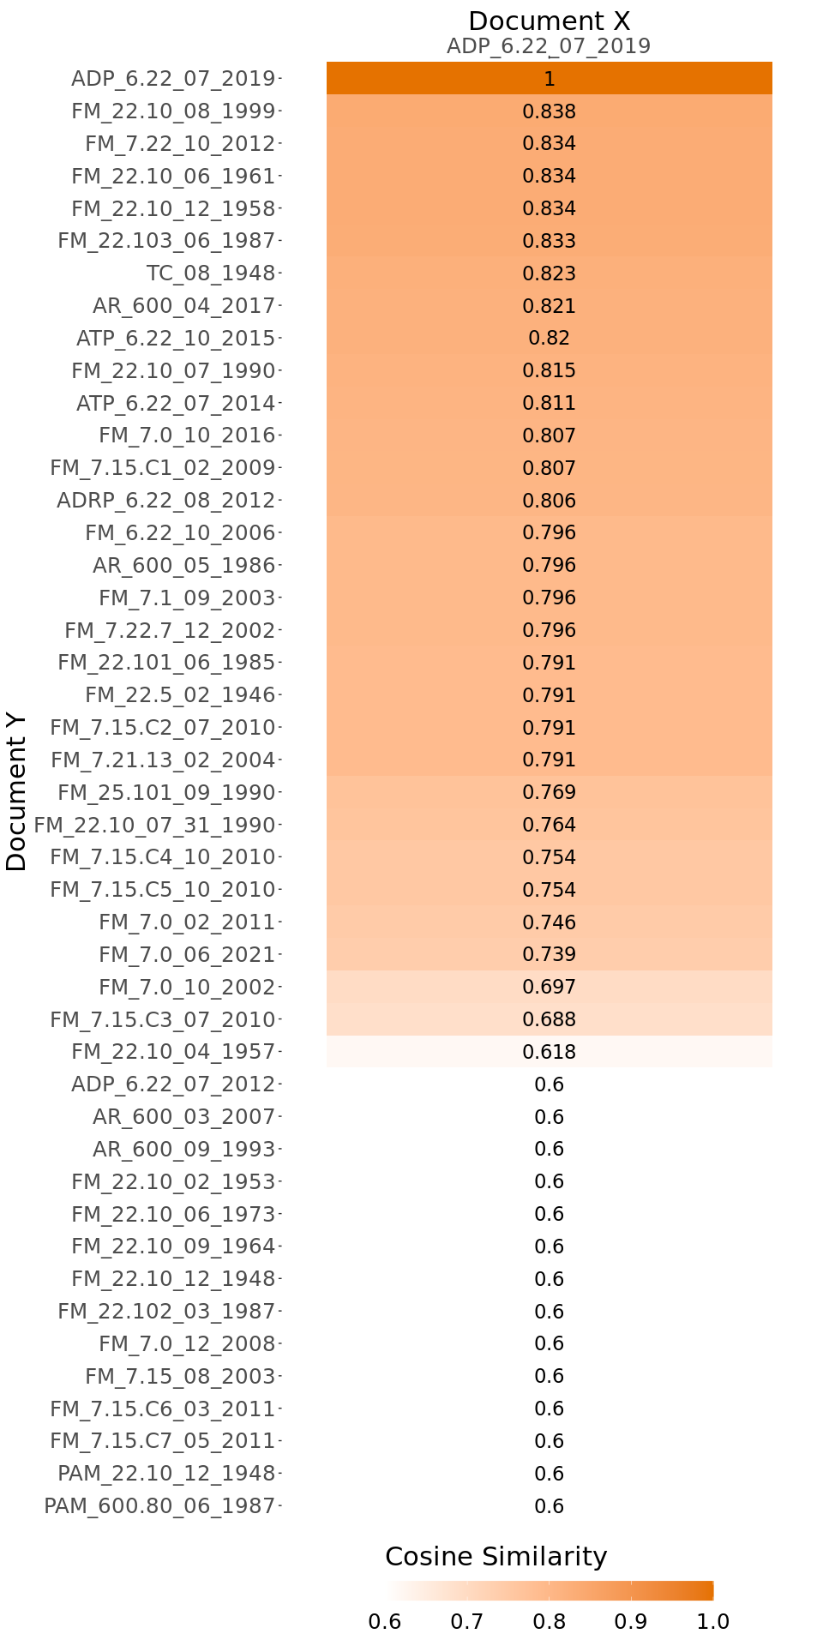
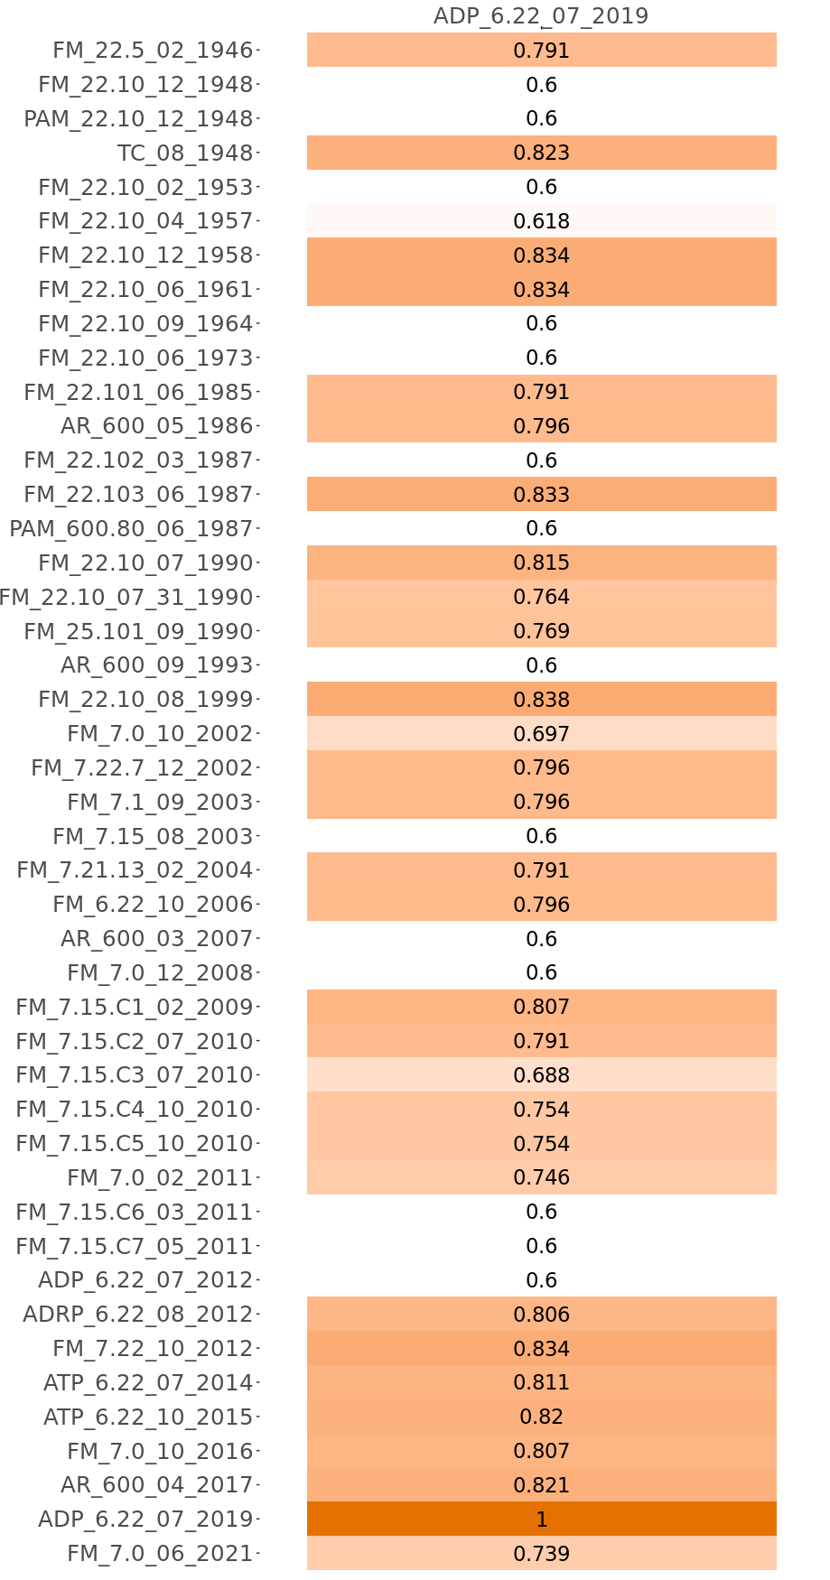
Example results: Cosine similarity between
Army Leadership and the Profession (Army Doctrinal Publication, 2019) and all documents
Leadership is the activity of influencing people by providing purpose, direction, and motivation to accomplish the mission and improve the organization
Leadership is the process of influencing others to accomplish the mission by providing purpose, direction, and motivation
Documents ordered by similarity
Documents ordered by year

Slide 8
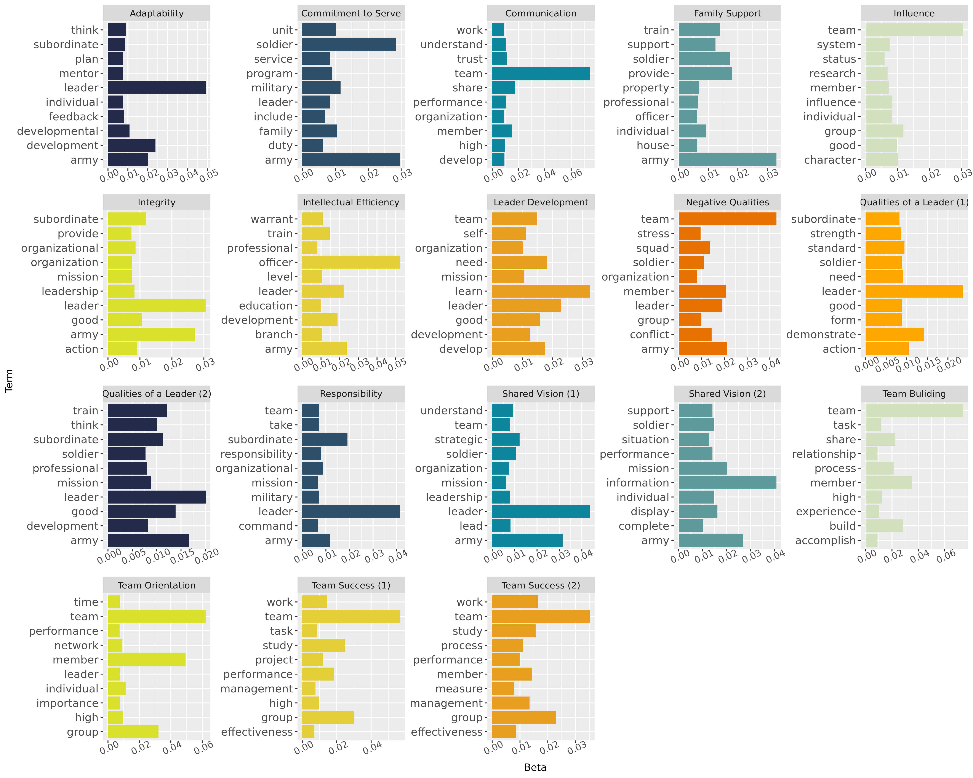
Comparing Manual vs. Automated Document Analysis
Manual Codes
Qualities of a Leader
Leader Development
Organizational Trust
Diversity in Team
Negative Qualities
Team Success
Shared Vision
Team Building
Responsibility
Cooperation
Influence
Intellectual Efficiency
Negation of Positive Qualities
Adaptability
Team Orientation
Commitment to Serve
Communication
Integrity
Bolded codes also appeared in automated analysis
18 Term Topic Model
Many manual codes appeared in topic models
  Adaptability
  Commitment to serve
  Leader development
Some manual codes did not appear in topic model
  Negation of Positive Qualities
One topic did not appear in manual codes
  Family support

Slide 9
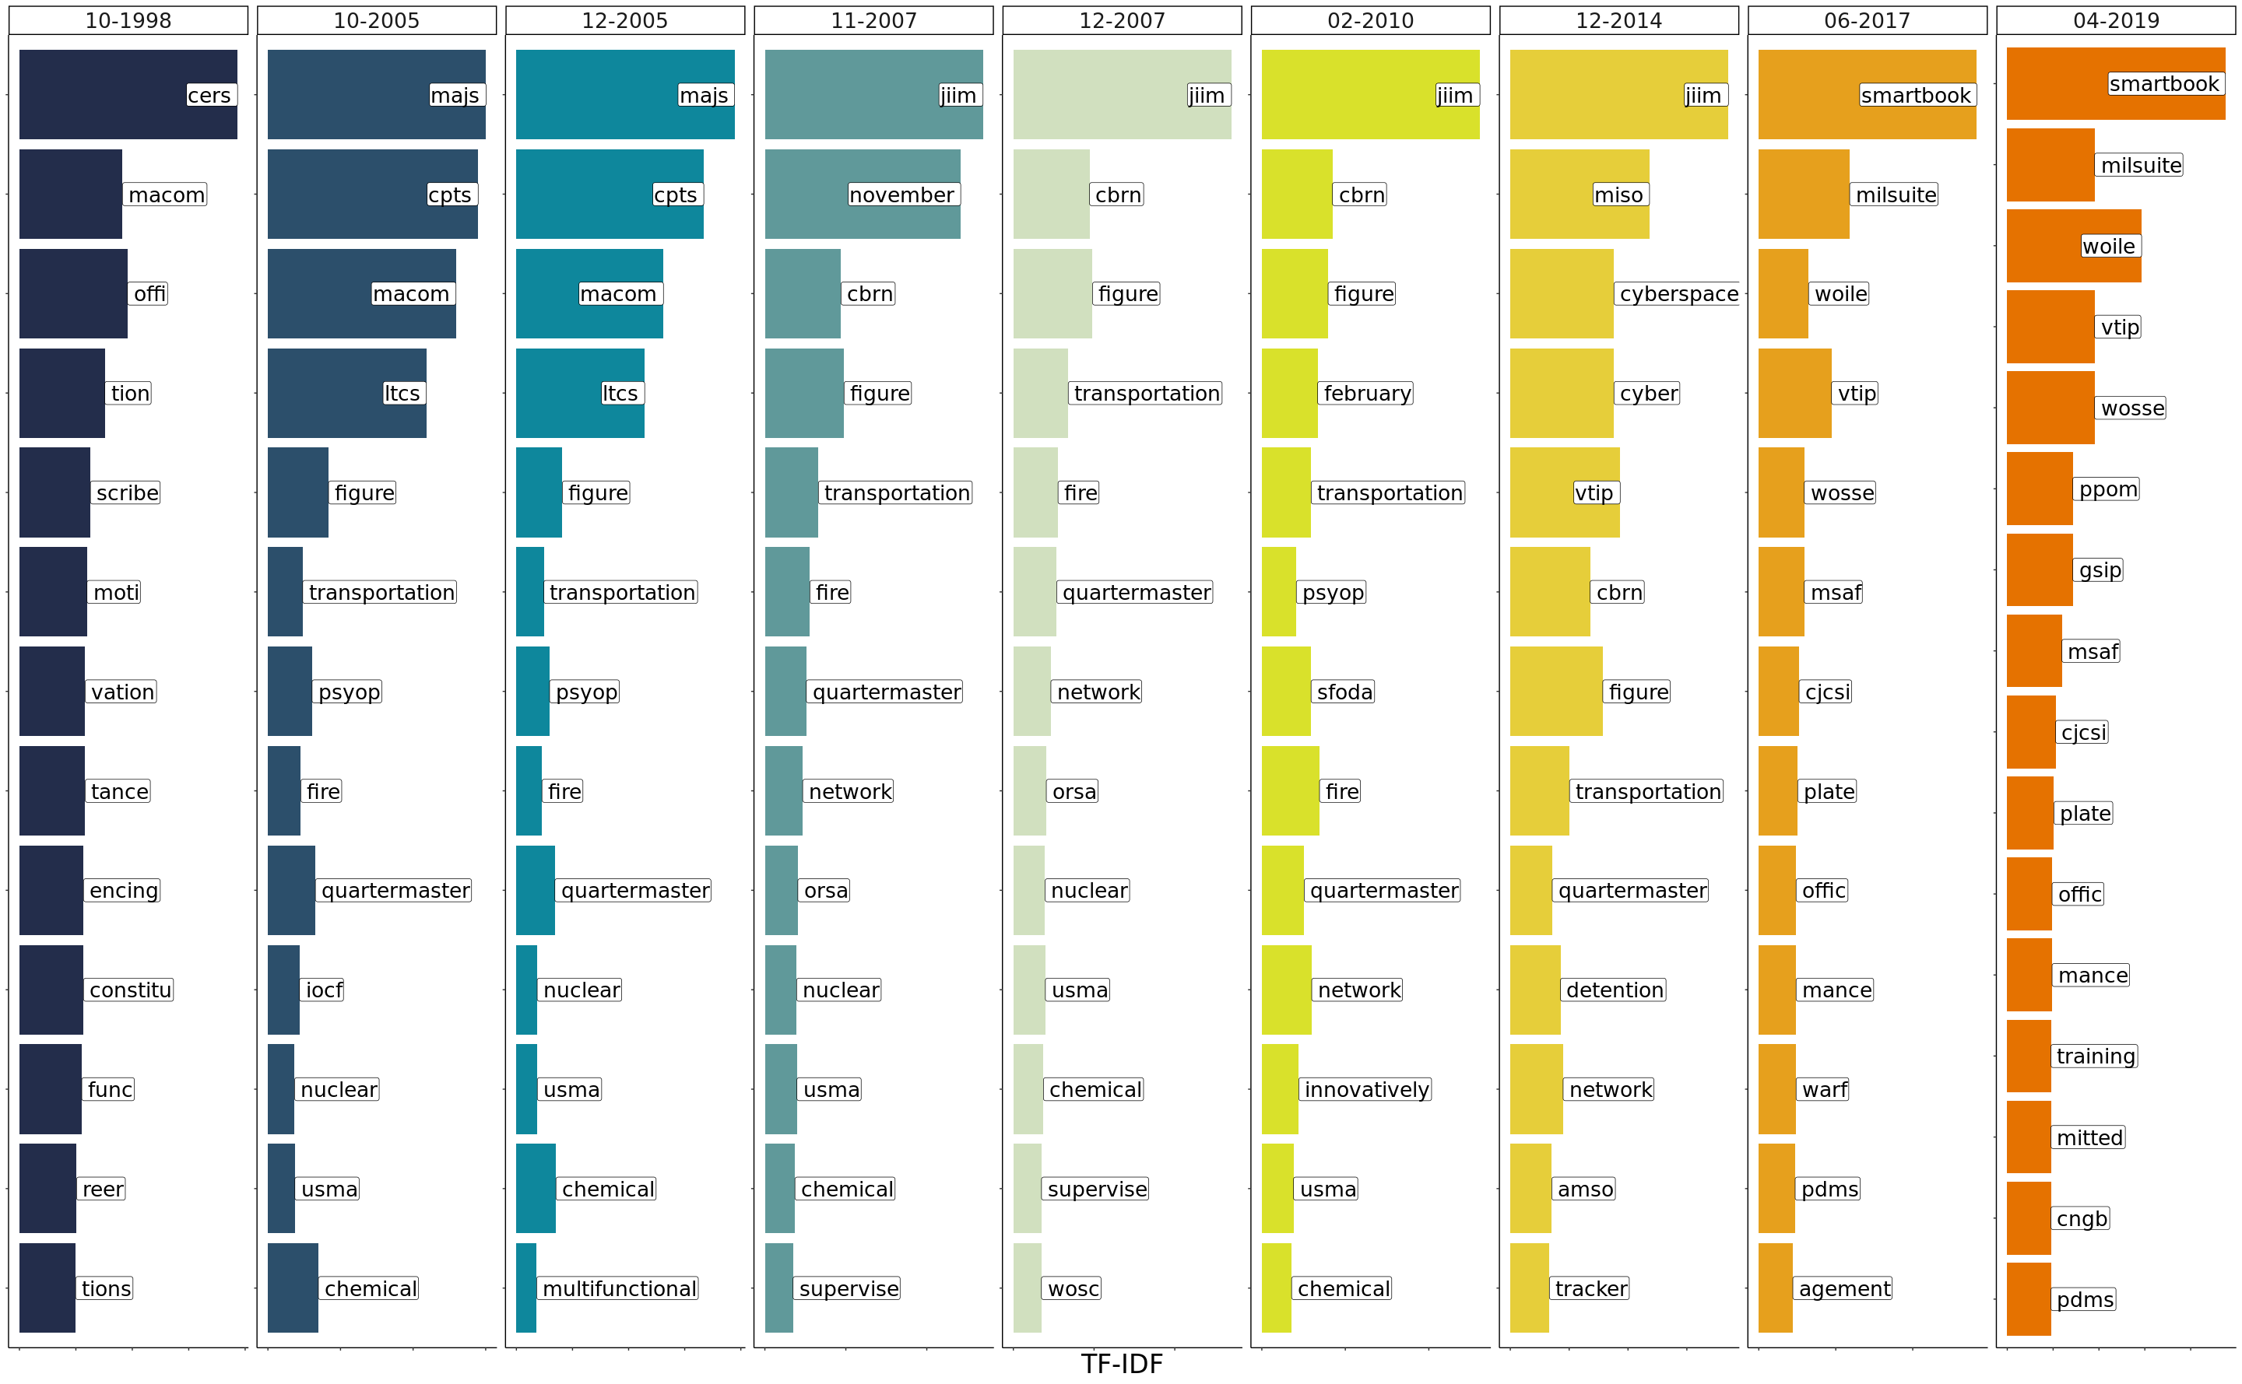
Changes in the Content of PAM 600-3 from 1998-2019
Officer Professional Development and Career Management (PAM 600-3) from 1998-2019
Unique words that occur most frequently in each document
Acronyms
  JIIM (joint, interagency, intergovernmental, and multinational)
  CERS (Consolidated Emergency Response System)
Rankings
  MAJs (majors)
  CPTs (captains)
Other topics
  Chemical
  Nuclear
  Transportation
  Cyber
Notes:
Take out acronyms as next step

